Slide 1
Brand Building and Networking and new age opportunities under forensic audit
Organized by: Navsari Branch of The WIRC
of The Institute of Chartered Accountants of India
CA Hardik Chokshi
------------------------------------------
14th August 2021

Slide 2
Note…
The views expressed are of the individual author based on invitation and are in his personal capacity based on an invitation... Said views are private in nature and may vary with views of any other individual
The views are general in nature, and not specific of any organisation, and should not be considered an expression of any suggestion or opinions

Slide 3
Statistics information – members in practice
Statistics 1/4/21 (Data source –ICAI) | Fellows |  |  | Associates |  |  | Grand total- fellows + associates | Percentage (%) of associates to fellows
 | In practice |  | TOTAL FELLOW | In practice |  | TOTAL ASSOCIATE
Region | Full time | Part time |  | Full time | Part time | Total
Western | 25388 | 620 | 26008 | 19217 | 1673 | 20890 | 46898 | 44.5
Southern | 18359 | 581 | 18940 | 9617 | 1029 | 10646 | 29586 | 36.0
eastern | 8014 | 170 | 8184 | 3819 | 358 | 4177 | 12361 | 33.8
central | 17787 | 344 | 18131 | 13059 | 748 | 13807 | 31938 | 43.2
northen | 17452 | 516 | 17968 | 11424 | 964 | 12388 | 30356 | 40.8
 |  |  | 89231 |  |  | 61908 | 151139
Firms statistics( source -public domain as at dec 20)
Details | Firms | Percentage (%)
1 | 62137 | 70.37
2-5 | 23831 | 26.99
6-10 | 1932 | 2.19
11-50 | 391 | 0.44
51 and above | 10 | 0.01
total | 88301 | 100.00
Note- some difference in above due to cut off date variations may remain.
TOTAL MEMBERS | NOS
Total in practice (ACA+ FCA) Including part time | 151139
not in practice | 175942
TOTAL | 327081

Slide 4
Firms which have scaled up…..
Those which have ventured into:-
1) Newer areas of practices
2) Developed sector specialization – eg. Media sector
3) Developed functional expertise
4) Networked and formed a larger structure – regional, national, international…
And others…

Slide 5
Branding-Being a trusted advisor
Considerations that may be relevant for professional services…
- Trusted advisor
- Differentiation
Years of services
Relevance to a larger audience
Quality
Any other…..

Slide 6
Integration
People
knowledge
Technology

Slide 7
Building the firm’s abilities
Internally…
- Identifying own strengths… SWOT
- Creating E-documentation & Digital Libraries
- Developing research papers / Important regulatory updates
- Maximizing Empanelment’s

Slide 8
Adding client trust and reliability….
- Developing specialized Experts within the firm… need not be partners
- Providing client options of Local level Reach – Alliances / Informal associations/ networks etc.
- Putting in place Confidentiality & Security measures

Slide 9
Consistency in expectation v/s deliverable
Client service - Quick turn around times , Emails replies
Adhering to agreed upon deadlines
Highest levels of Quality of Reporting –
Developing Internal SOP’s for areas such as
Internal audit, statutory audit, tax audits etc.
Saying “No” may matter at times

Slide 10
Building the IT infrastructure-
- Raising of Hardware standards
- Cloud infrastructure – SaaS models
- Tracking productivity remotely
- Employee up-skilling to use of technology

Slide 11
New normal for practicing CA – Having a 360 degree view of client requirements
- Digitization is a multi stage process
- Digital and paperless offices & services
Automating repetitive tasks
Re-Investing in technology
Remote audit , risk and compliances, E-fraud
assessment, faceless assessments…
Embracing Technology

Slide 12
Firms - VIRTUAL v/s PHYSICAL …
Factors…
- Client requirements
- Local (city/town) working preferences
- Service infrastructure
- Staff availability
Can Hybrid working styles prevail ? Work from home & office together

Slide 13
Presences in public domains
Websites
Social media platforms
Alumni networks – Students/ CA’s / Graduates etc.

Slide 14
Advocating Make In India…
Localization of service
Supporting Local firms in tier 2 /3 cities etc. to network
Identifying Opportunities to work more with existing clients

Slide 15
Capacity building
Empowering Indian firms ….
ICAI has Enabled options...
- Networking
- Multi disciplinary firms
- Corporate Structure.
- Formation of LLP
- Merger

Slide 16
Endeavoring Global Reach..
Examples…
Outsourcing –Tax /audit support
Data Analytics
Forensics accounting /forensic audit
Supporting GAAP translations
Supporting indian cos. for Local compliances
co-sourcing, cfo service
Opportunities to work together…
Networking within icai guidelines
Local firms outside india
The whole world is my stage…
Develop Practice with a global perspective

Slide 17
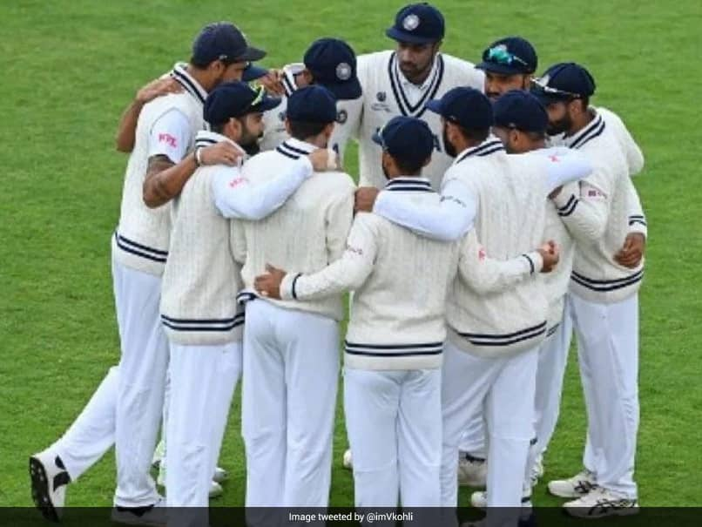
Mentoring / Fellowship
Promoting young firms/students
Outreaching Members
"We Move Ahead. Together”
- Virat Kohli's Tweet
after defeat in World Test championship Final 2021.

Slide 18
Networking guidelines
Key differentiators | Alliance | Network
 |  | B1 | B2
Structure | Firms form an alliance | Networking in existing model and firms practice in individual names | Network of firms with a lead firm acting on behalf of constituent of firms
Network name (eg. 3 firms A, B, C) | ABC & Alliance | ABC Network | A & affiliate (where A is lead firm)
Branding of name | Display of alliance in professional stationary | Display of network in professional stationary | Display of alliance in professional stationary
Registration | Alliance no | Network no. | Network no.
Empanelment | All firms can separately apply for audit services in individual name subject to independence (eg. statutory v/s internal, audit v/s non audit) | All firms can separately apply for audit services in individual name subject to independence (eg. statutory v/s internal, audit v/s non audit) | Lead firm to apply, other firms in network cannot apply
Independence | Alliance firms can have best practices , but not bound by each firm | Firms bound by internal integration agreement, Network decision final on all firms | Firms bound by internal integration agreement, One firm is identified as lead firm

Slide 19
Working together …joint pan India audits… eg. Joint bank concurrent audit
STEP 1
LF- Leads Client relations,
Conducts Off site activities like Analytics
STEP 2
NF- Analytics and on-ground checks at local branch
STEP 3
LF – Discusses with NF
STEP 4
NF- documentations, on-ground reviews and discussions
STEP 5
LF- quality controls, Joint reporting, submits reports to client
lead firm- “LF”
Associate /Network partner- “NF”

Slide 20
Opportunities – upcoming areas
Through Expansion of services portfolio & local reach…
Forensic- fraud RISK assessment in banks, companies etc. (KYC, ETC)
RERA
Estate planning / succession planning, other Hindu laws, family laws
Automation of processes
Independent directorship (incl. woman director )
Msme / Start ups – one stop accounting/tax/secretarial/directorship/ due diligence/ valuations/FEMA etc. Tie ups with merchant bankers/legal etc.
CFO services
Insolvency and bankruptcy services – cash flow monitoring, monitoring stock & receivable
Services requiring local level supports.– networking/alliances
Pre-Investment Due diligence

Slide 21
Guidelines – ICAI, others.
Care…
------------
Code of ethics
Website guidelines
Adherence to Networking guidelines such as conflict of interest, mutual understandings etc.
--
Other matters - CAG…Empanelment

Slide 22
Forensic

Slide 23
Changes on the ground…
Enhanced Regulatory & Law Enforcement oversight (MCA Shell cos list, SFIO, fugitive offenders, black money act )
Crisis Management - Quicker Responses required towards Allegations (early warning signals)-- Companies Act, Corporate Governance , Director/ Trustee liabilities
Emerging technologies viz. “Internet of Things” , “Cloud computing”, generating data
Organizations encouraging constructive challenges by auditors.
Fraud has been defined at various regulations / law

Slide 24
Investigations Completed by SFIO
Financial Year | Investigation Completed
2016-2017 | 87
2015-2016 | 60
2014-2015 | 39
2013-2014 | 22
2012-2013 | 22
2011-2012 | 20
2010-2011 | 13
2009-2010 | 12
Source - https://sfio.nic.in/investigation-completed

Slide 25
Forensic audit work streams..
Reviewing controls for early warning signals
Consultation - Fraud risk Assessment framework aligned to an organization’s risk profile.
Fraud
Prevention
Assisting in legal proceedings including testifying in court as an expert witness
Preparing visual aid to support trail evidence
Investigating and analysing financial evidence
Providing
Expert
Testimony
Fraud
Detection
Forensic
Audit work streams
Examine un-structured data with regard to incidents of financial crime
Discover and analyse patterns of fraudulent activities
Assisting in data recovery
Analysis of data on digital devices.
Computer
Forensics
Forensic
Data
Analysis

Slide 26
Investigation – Qualitative approach…
By way of…
Advanced Risk based auditing techniques
Technology tools
Networking - On-ground Surveillance -Local reach
Tie up with Forensic Laboratory
Any other….

Slide 27
Achieving the purpose
Goal
Strategy
Systems
Staff & Skills
Standards -FAIS
Statute
Forensic Accounting & Investigation Standards
- As notified

Slide 28
Process Flow …
Step 1
Step 2
Develop a
Strategy
Step 3
Perform
Analysis
Step 4
Obtain Relevant Evidence
Step 5
Step 6
Court
Proceedings
Initialization
Reporting
▪ Fact based reporting
▪ Report covers…
Approach, Limitations,
Methodology,
Detailed Findings
&
Evidence gathered during audit
▪ Discussing with appointing agency
Entering into Engagement letter
Develop a strategy.
Interviews
Preliminary leads
External data
▪ Summarize humongous data
▪ Perform Data
Integrity checks
▪ Usage of AI model for data analytics
▪ Perform asset tracing, utilisation of disbursed funds to assess as diversion , siphoning etc.
▪ Prepare charts and graphics providing outliers
▪ Identify specific type of fraud committed,
How same is committed
▪ Gather evidence depending upon the nature of the case, which may involve
o locating
documents
o economic
information
o proof of occurrence of an event
Identifing beneficiaries
▪ Retention of records
Cross examination
Visits to Law enforcement agencies

Slide 29
Emerging areas in Investigation…
Forensic imaging and analysis of servers, laptops, and mobiles
GST compliant businesses? – Proactive in Servicing SME businesses and Boards- vendor genunity, bogus sales, ITC etc.
RERA – end use, project certifications, etc.
Insider Trading & Unfair Market practices - Capital market intermediaries
Tax Investigation - M&A, Special audits, Tax dept.
Pre-employment screening
Outsourced processes - Supply Chain, other Service providers.

Slide 30
Emerging areas in Investigation...
Agency for specialized Monitoring(ASM) / Forensics --Transaction audit
FEMA – Money laundering/round tripping, Trade finance transactions
Emerging Technology risk - Cyber Security, Online payment, data integrity etc.
Anti Bribery, Intellectual property rights violation.
Support to Legal firms / Resolution professionals/ liquidators – Asset search, forensic, accounts review, revision / restating of accounts…
Others…

Slide 31
THANK YOU DEAR COLLEAGUES
CA HARDIK CHOKSHI

