Slide 1
Setting up an Investigation practice by Small & Medium Practitioners Organized by: The Western India Regional Council of India of ICAI of The Institute of Chartered Accountants of India
- By CA Hardik Chokshi

Slide 2
CHANGING SCENARIO
01
DIGITAL PLATFORMS
02
03
TABLE OF CONTENTS
CONTROLLING STAFF PRODUCTIVITY
05
EMERGING AREAS
04
CONSISTENT PRESENATATION OF EXPECTATION & DELIVERABLE

Slide 3
01
Changing Scenario

Slide 4
Why set up Investigation practice?
Enhanced Regulatory Enforcement
Organizations encouraging constructive challenges by auditors.
Quicker Responses required towards Allegations (early warning signals)-- Companies Act, Corporate Governance , Director/ Trustee liabilities
Emerging technologies viz. “Internet of Things” , “Cloud computing”, generating data

Slide 5
Investigation - “what matters”
Advanced Risk based auditing techniques
Use of Digital Platforms - (google earth, social media, etc..)
On-ground Surveillance capabilities (Local reach)
Assessing Credibility of source of data, Admissibility of Evidence

Slide 6
Project
Goal
Strategy
Systems
Staff & Skills
Standards---
FAIS
Statute
(Forensic Accounting & Investigation Standards – As notified)

Slide 7
02
Digital platforms

Slide 8
Digital Platforms of audit
Automating task - data extraction & conversion, sampling tools
Auditing through Visualization - Video call, Google Geo Track, Apps, Drones
Recording of audit work in repositories

Slide 9
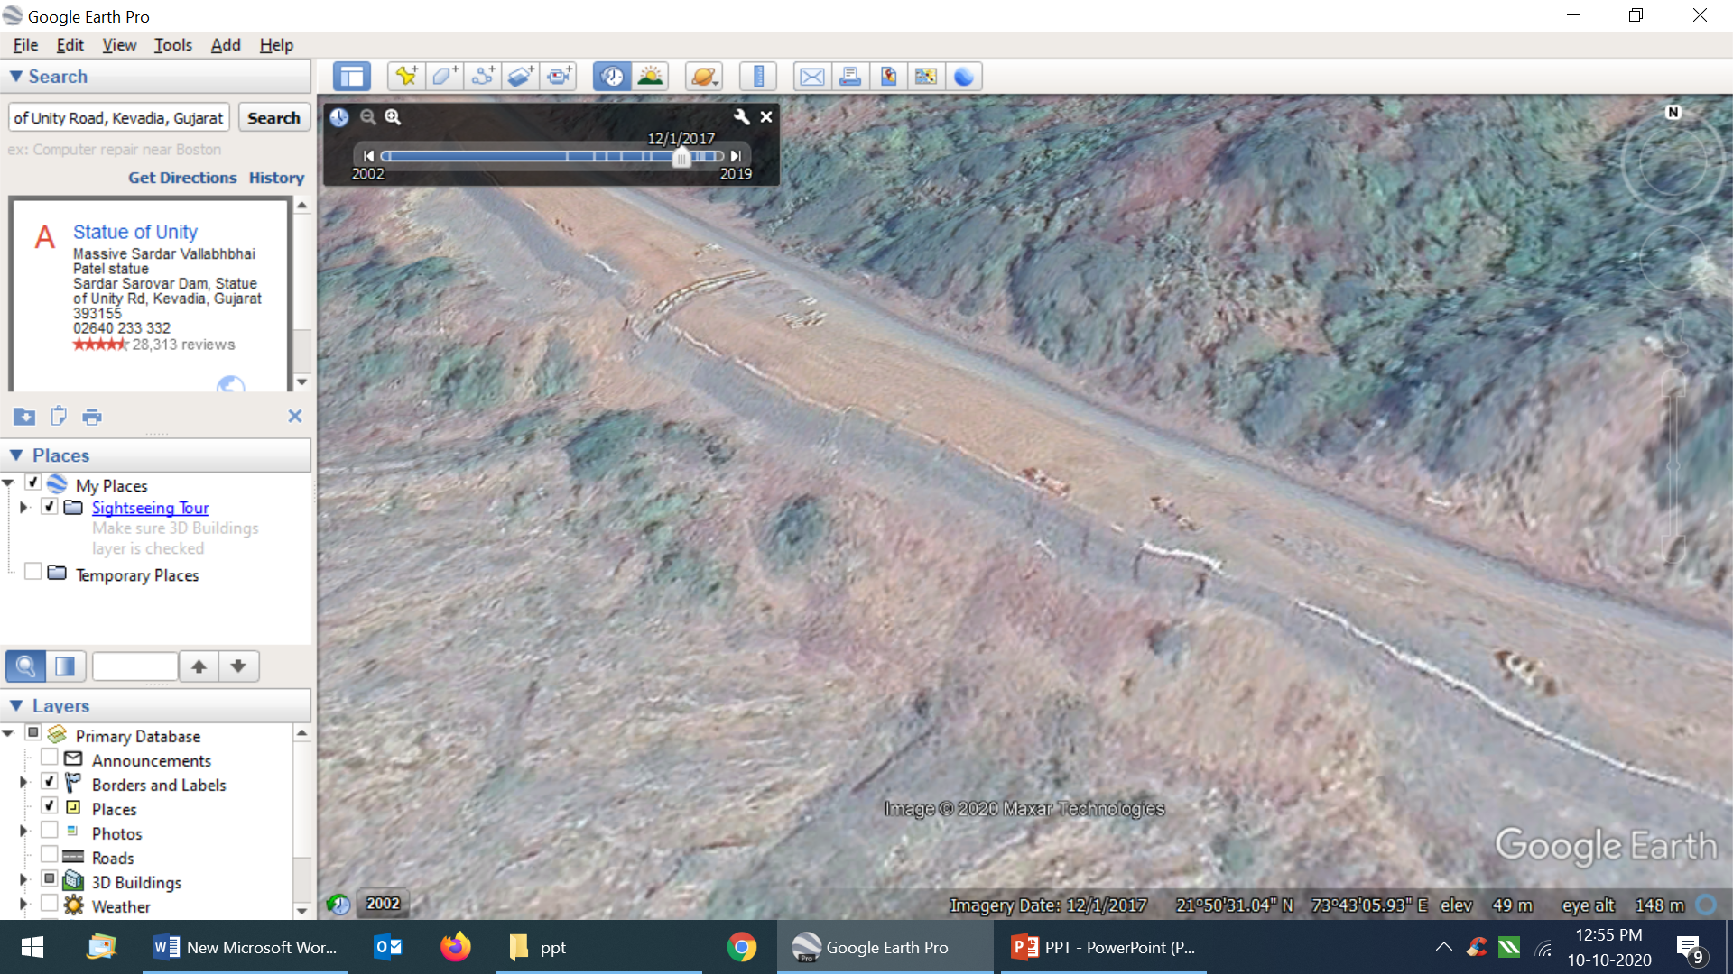
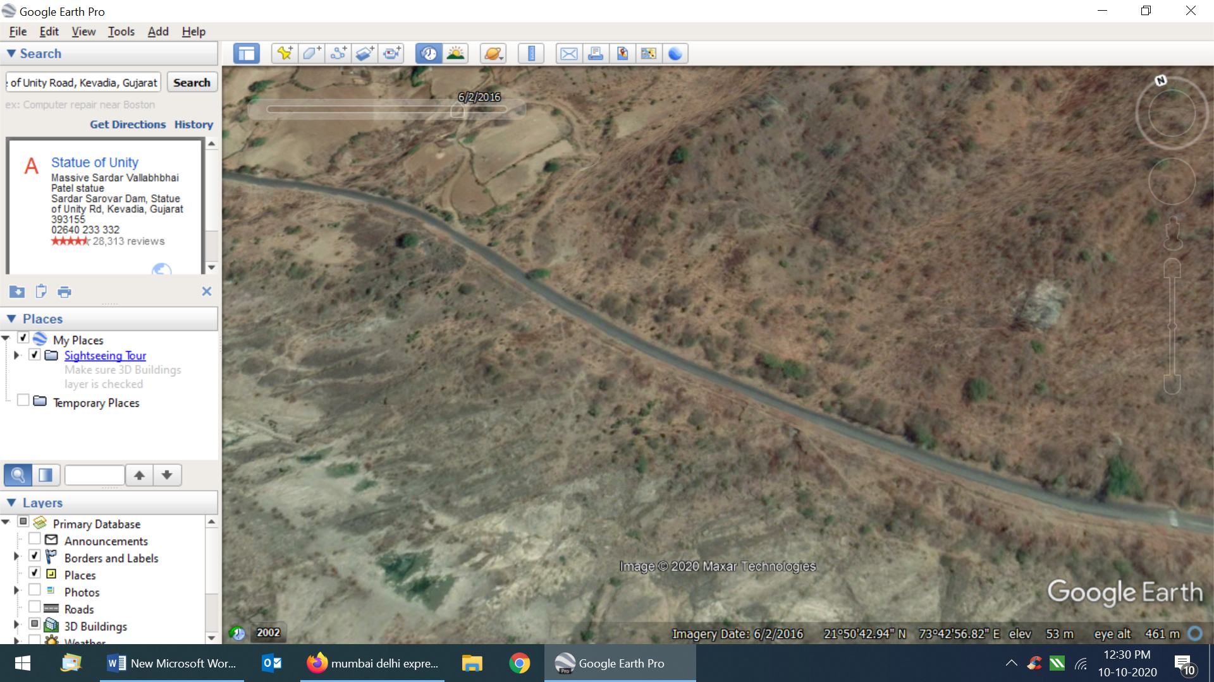
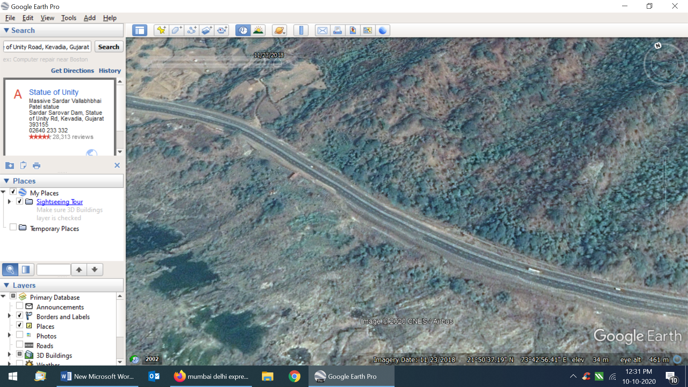
2nd June‘16
GOOGLE Earth Live
Monitoring stage of project
1st dec’ 17
23rd Nov ‘18

Slide 10
USING SOCIAL MEDIA - PREDICTIVE ANALSYIS
For tracking individual’s current activities
For finding undisclosed related parties
Analysing trends, lifestyles
For finding undisclosed major events

Slide 11
IT Tools –example
Illustrated examples for general information:-

Slide 12
Open source of data base
Litigation | Credit & Compliance | Media & Internet | Regulatory database
Hon’ Supreme Court of India, Hon’ High court India Kanoon E-jurix | Credit Rating CIBIL NSE | Google One source MCA Zauba Bloomberg | SEBI Investor forums CBI

Slide 13
03
CONTROLLING STAFF PRODUCTIVITY

Slide 14
Staff Productivity, Networking
Evaluation Remote working
Networking with CA Firms in various cities for leveraging strengths
Tracking of productivity - IT tools for task management
Promoting a culture of entrepreneurship

Slide 15
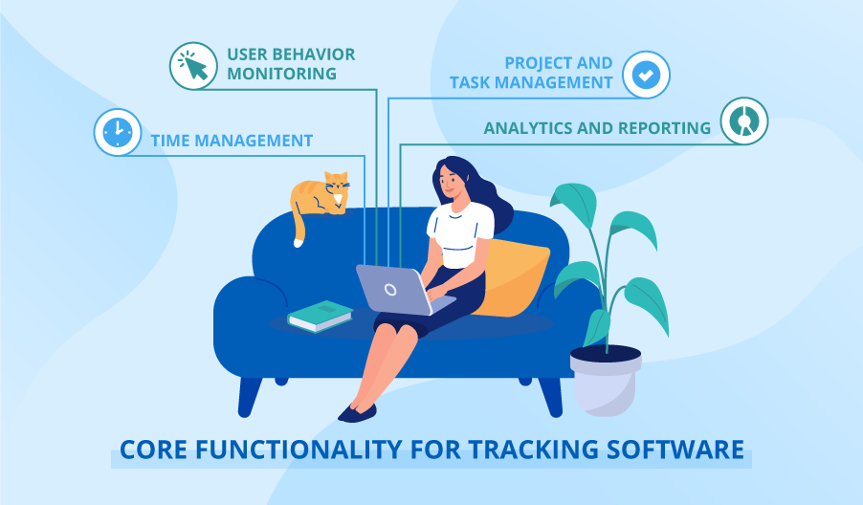
TRACKING PRODUCTIVITY-THE FUTURE OF WORK FROM HOME
Collaboration platforms such as Slack, Trello, etc.
Task & Document Management platforms
Tracking productivity is necessary to avoid client lags

Slide 16
04
CONSISTENT PRESENATATION OF EXPECTATION & DELIVERABLE

Slide 17
Bridging the expectation v/s deliverable gap
Servicing client a complex process –
Timelines / Trust / Engagement letter / Record keeping / Report drafting
SMP’s own Audit SOP’s
Resource capabilities - Networking with members & other experts

Slide 18
05
EMERGING AREAS

Slide 19
Creating portfolio of services
Fraud Investigations
Fraud Risk Assessments.
Proactive fraud vulnerability assessment
Devising Anti-fraud policy and training
Pre-Investment Due diligence
Financial Frauds
Forensic imaging and analysis of servers, laptops, and mobiles
Money Laundering
Early warning signals /whistle blower
Employee trading guidelines
Governance
Implementing Hotline to enable Whistle Blowing
Data Privacy/ Anti corruption
Code of ethics
GDPR compliances
Cybersecurity

Slide 20
Assistance in search & surveys
Forensic Imaging - Use of forensic tools to capture evidence, preserve to prove the same in the court of law.
Review of seized data post search/survey
Regular Updates to agency
initial interviews that support locating vital evidences

Slide 21
Emerging areas in Investigation…
GST compliant businesses? –Proactive in Servicing SME businesses and Boards- vendor genunity, bogus sales, ITC etc.
RERA – end use, project certifications, etc.
Process verification at Banks - credit , swift, kyc etc.
Insider Trading & Market practices/Governance - brokers / DP / various capital market intermediaries
Tax Investigation - M&A, Special audits, Tax dept.
Outsourced processes - Supply Chain, other Service providers.
Agency for specialized Monitoring(ASM) / Forensics --Transaction audit
FEMA – Money laundering/round tripping, Trade finance transactions

Slide 22
Emerging areas in Investigation...
Decoding Ind AS FS for Investors/credit rating/regulators/Agencies etc.- Gap assessment, Expected credit loss calculations etc.
Due Diligence & takeovers
Insurance – Claims , Commission pay-outs, marketing expenses
Emerging Technology risk - Cyber Security, Online payment, data integrity etc.
Evaluating effectiveness of automated controls (eg. IOT)
Anti Bribery, Intellectual property rights violation.
Support to Legal firms / Resolution professionals/ liquidators – Asset search, forensic, accounts review, revision / restating of accounts…
Others…

Slide 23
Certain Regulations & Empanelment
Section 212 of Companies act, 2013 – Supporting Boards Prior to any Regulatory intimations
Indian Bank Association / RBI - Loan Restructuring , Agency for specialized monitoring
Insolvency act -Transaction Audits
SEBI - Forensic audits listed cos, Inspection of DP’s, brokers, Mutual funds etc.
Income tax – Special audits, Data analysis in tax Raid matters.
Any other……

Slide 24
THANK YOU
from
CA HARDIK CHOKSHI

